Slide 1
LAB – 2 Operating Systems

Slide 2
GroupID - 6
Abhijeet Sonkar
Aditya Aggarwal
Ambika Singh
Avneesh Kumar
Divy Agrawal
IIB2019009
IIT2019210
IIB2019017
IIB2019010
IIT2019211

Slide 3

Questions Assigned
1F
Create your own SHELL-commands to simulate (mimic) the functionality of the well-known SHELL command cut .
Write a SHELL Script which takes a source pathname/filename and a destination pathname from the user, checks whether the source file and the destination pathname (directory) exists. If not, prompts to the user to correctly provide the inputs. When it receives correct inputs, asks the user to input values for a delimiter and a field-number. It then executes your mycut command with the -d and -f options with the specified values of delimiter and field-number on the input file. The output of the execution is not displayed on the terminal; rather, it is redirected to a newly created file called output which is placed in the destination directory as mentioned by the user
2F

Slide 4
Table of Contents
1
2
3
4
In section 1 we will be discussing about the cut command in UNIX.
In section 2, we will make the flowchart of the code.
In section 3, we will be explaining our code of both mycut.cpp and script.bash
In section 4, we will be sharing some output screenshots for the program.

Slide 5
What is cut command?
1
Lets brielfy know about cut command.

Slide 6
The cut command in UNIX is a command for cutting out the sections from each line of files and writing the result to standard output. It can be used to cut parts of a line by byte position, character and field. Basically the cut command slices a line and extracts the text. It is necessary to specify option with command otherwise it gives error. If more than one file name is provided then data from each file is not precedes by its file name.
$ cut OPTIONS… [FILE]…
Syntax

Slide 7
The options that tell cut whether to use a delimiter, byte position, or character when cutting out selected portions the lines are as follows:
-f (--fields=LIST) - Select by specifying a field, a set of fields, or a range of fields. This is the most commonly used option.
-b (--bytes=LIST) - Select by specifying a byte, a set of bytes, or a range of bytes.
-c (--characters=LIST) - Select by specifying a character, a set of characters, or a range of characters.

Slide 8
Flow Chart
2

Slide 9
mycut.cpp
Start
Compile code
Execute binary file, with command line argument
Is [ f ] option present?
Yes
No
Is [ d ] option present?
No
Stop
Assign Tab as delimiter
Show Error
Yes
No
Is [ file name ] provided?
Program Executed Successfully
Yes
Yes
Is any other options present?
Print the column according to specified field values.
No
Open file specified by user
No
No
Yes
File opened successfully?
Does set contains valid field values?
Generate set of field values from given string
Spilt each line into specified delimiter
Yes

Slide 10
script.bash
Start
Ask pathname of file
File exist?
Yes
Ask destination path
No
No
Stop
Directory exist?
Yes
Store output in output file in destination directory
Ask delimiter
Run mycut and provide appropriate argument
Compile mycut.cpp
Ask field number

Slide 11
Code Explanation
3
Lets brielfy discuss the code

Slide 12
int main(int argc, char **argv)
{
bool DELEMITER_SPECIFIED = false;
bool FIELD_NUMBER_SPECIFIED = false;
int c;
int digit_optind = 0;
char delimiter;
string str_fieldNumber;
In this portion of Program, we have declared some variable.
Here main() function is taking to arguments argc and argv.

Slide 13
while (1)
{
int this_option_optind = optind ? optind : 1;
int option_index = 0;
static struct option long_options[] = {
{"fields", required_argument, NULL, 'f'},
{"delimiter", required_argument, NULL, 'd'},
{NULL, 0, NULL, 0}};
c = getopt_long(argc, argv, "d:f:", long_options, &option_index);
if (c == -1)
break;
switch (c)
{
case 'd':
DELEMITER_SPECIFIED = true;
delimiter = optarg[0];
break;
case 'f':
FIELD_NUMBER_SPECIFIED = true;
str_fieldNumber = optarg;
break;
default:
break;
}
}
if (optind < argc)
{
bool INVALID_OPT_FOUND = false;
while (optind < argc)
{
string _argv = argv[optind++];
if (_argv.length() > 1)
continue;
else
{
cout << _argv << " ";
INVALID_OPT_FOUND = true;
}
}
if (INVALID_OPT_FOUND)
{
printf(": option(s) not available.\nTry using [d] and [f] options");
exit(0);
}
}
This part of code uses getopt_long() function to fetch options and their argument values by parsing the array of arguments i.e. argv.
An element of argv that starts with '-' is an option element.
When getopt_long() is called repeatedly, it returns successively each of the option characters from each of the option elements.
And it returns -1 when there are no more option characters left in argv.
“d:f:” here is termed as optstring, which shows that d and f are options and they both require an argument.

Slide 14
if (FIELD_NUMBER_SPECIFIED)
{
char buffer;
int i = 0;
string line;
char delim = (DELEMITER_SPECIFIED == true) ? delimiter : '\t';
vector<string> splitWords;
int fileIndex = (DELEMITER_SPECIFIED) ? 5 : ((!DELEMITER_SPECIFIED) ? 3 : argc - 1);
if (argv[fileIndex] == NULL)
{
cout << "mycut: file pathname not provided." << endl;
exit(0);
}
int fd = open(argv[fileIndex], O_RDONLY);
if (fd == -1) // file DNE
{
perror(argv[fileIndex]);
}
If delimiter is specified by the user then store it in delim else store tab as it’s default value.
If the delimiter is provided by the user then filename is stored at 5th position else stored at 3rd position in the argument list.
If filename is not specified or is not valid then print error and exit.
If filename is valid open it using syscall.

Slide 15
else if (fd >= 0)
{
string str;
int endOfFile = 0;
while ((endOfFile = read(fd, &buffer, 1)) >= 0)
{
if (buffer == '\n' || endOfFile == 0)
{
size_t pos = 0;
if ((pos = line.find(delim)) == string::npos)
{
cout << line << endl;
line.clear();
splitWords.clear();
}
else
{
pos = 0;
string token;
vector<string> printWord;
while ((pos = line.find(delim)) != string::npos)
{
token = line.substr(0, pos);
splitWords.push_back(token);
line.erase(0, pos + sizeof(delim));
}
splitWords.push_back(line);
set<int> fieldNumbers = generateFieldNumber(str_fieldNumber, splitWords.size());
for (auto i : fieldNumbers)
{
if (i - 1 < splitWords.size())
{
printWord.push_back(splitWords[i - 1]);
}
}
for (int i = 0; i < printWord.size(); i++)
{
if (i == (printWord.size() - 1))
cout << printWord[i];
else
{
cout << printWord[i] << delim;
}
}
cout << endl;
line.clear();
splitWords.clear();
printWord.clear();
}
}
else
{
line.push_back(buffer);
}
if (endOfFile == 0)
{
break;
}
}
}
Syscall to read file character by character and store it in a buffer.
When the line does not contain the delimiter then print the whole line.
Split the line according to the delimiter and store the word in spliwords Array.
All the word to be printed are stored in printWord array
Printing the whole array printword array
Breaking the loop when end of the file is reached.

Slide 16
Explanation of generateFieldNumbers() function
generateFieldNumber(string fieldString,int maxLength)
This function basically checks whether the given fieldvalue is valid or not. If valid, it then process the string and extract range of numbers from the string. eg. Of some invalid fieldvalues are alphabets, symbol other than comma, hyphen, 0 as one of its value.
4 types of values can be provided in field string, and we process each type of fieldvalues individually and insert the values in a set.
set<int> fieldNumbers;
The 4 type of field values are :-
Normal integer values: eg. 3,4,45..
if (count(i.begin(), i.end(), '-') == 0)
{
int temp = atoi(i.c_str());
fieldNumbers.insert(temp);
}

Slide 17
Range value which start with hyphen at the start
Like -5, -7 ,- 10 etc
-5 basically means 1,2,3,4,5
if (*i.begin() == '-') {
i.erase(i.begin());
int temp = atoi(i.c_str());
for (int i = 1; i <= temp; i++) {
fieldNumbers.insert(i);
}
}
Range with end with hyphen like
4-,5- ...etc
4- mean 4,5,6,7,...... till the end of the column
- Here maxLength is the
length of the column.
i.pop_back();
int temp = atoi(i.c_str());
minField = min(minField, temp)
for (int i = minField; i <= maxLength; i++){
fieldNumbers.insert(i);
}

Slide 18
Range with hyphen at the middle
Like 4-7,3-10…...etc; 4-7 means 4,5,6,7
string firstString;
int a = 0;
while (i[a] != '-')
{
firstString.push_back(i[a]);
a++;
}
int firstNumber = atoi(firstString.c_str());
string secondString;
while (a < i.size())
{
secondString.push_back(i[a]);
a++;
}
secondString.erase(secondString.begin());
int secondNumber = atoi(secondString.c_str());
if (secondNumber < firstNumber)
{
validField = false;
}
for (int x = firstNumber; x <= secondNumber; x++)
{
fieldNumbers.insert(x);
}

Slide 19
Bash code Explanation
#!/bin/bash
IFS= read -r -p "Please Enter the absolute pathname of the file: " pathname
unset IFS
if [ ! -f "$pathname" ];
then
echo "No such file exists!!!!"
flag=0
while [ $flag -eq 0 ]
do
IFS= read -r -p "Please Enter the correct absolute pathname of the file: " pathname
unset IFS
if [ -f "$pathname" ];
then
flag=`expr $flag+1`
echo "file found!"
break
else
echo "No such file exists!!!!"
continue
fi
done
fi
-r option of read command is used to take input without interpreting the backslash escapes like ‘\n’, ‘\t’, ‘\b’ etc. So basically it is used here as the pathname of file or directory may contain backslash characters. And IFS option before read command is to prevent leading/trailing whitespace from being trimmed. -p option output the string prompt message without a trailing newline before attempting to read the input to be given by the user.
so IFS= read -r -p msg var_name is used here to display the prompt message and read the absolute pathname of file on which we have apply cut command until a newline character or enter key is pressed by the user. then we will unset the environment variable IFS.
Now we will check whether the absolute pathname of the file given by the user is correct or not using the -f option which returns true value if file exists and false if not. if the pathname entered by the user is correct then rest of the code here is skipped. but if the pathname entered by the user is incorrect then we will ask for the correct pathname until we receive the correct pathname using the while loop. here the value 0 of the variable named flag denotes that we have not received correct pathname till now and value 1 denotes that correct pathname has been received. And while loop will run until correct pathname is received. And as soon as correct pathname is received the flag variable becomes 1, “file found ” is printed and we break the while loop.

Slide 20
IFS= read -r -p "Please Enter the absolute destination pathname: " destination_name
unset IFS
if [ ! -d "$destination_name" ];
then
echo "No such directory exits!!!!"
flag=0
while [ $flag -eq 0 ]
do
IFS= read -r -p "Please Enter the correct absolute destination name: " destination_name
unset IFS
if [ -d "$destination_name" ];
then
flag=`expr $flag+1`
echo "directory found!"
break
else
echo "No such directory exits!!!!"
continue
fi
done
fi
similarly as explained in previous slide, IFS= read -r -p msg var_name is used here to display the prompt message to enter the absolute destination pathname where output file is to be stored. and read the absolute pathname of destination directory until a newline character or enter key is pressed by the user. this pathname is stored in the variable named destination name. then we will unset the environment variable IFS.
similarly as explained in previous slide, here also we will check whether the destination pathname inputted by the user is correct or not using the -d option which returns true if the directory exists and false if doesn’t exist. if the inputted destination pathname is correct then the rest of code here also is skipped. But if the inputted destination pathname is incorrect then we will ask user again and again to enter the correct destination pathname until he enters the correct path using the while loop. similarly here the variable named flag has the same purpose as before and as soon as correct destination path is entered flag variable becomes 1, “directory found ” is printed and we break the while loop.

Slide 21
IFS= read -r -p "Please enter the Delimiter: " delimiter
unset IFS
read -p "Please enter the fieldnumber: " fieldnumber
out="/output"
destination_file=$destination_name$out
`touch "$destination_file"`
`g++ mycut.cpp -o mycut`
`./mycut - d "$delimiter" -f $fieldnumber "$pathname" > "$destination_file"`
exit
Now we will ask the user to enter the desired delimiter normally without double quotes. here also we will use -r option to ignore the interpretation of the backslash escape characters and take input until enter is pressed and -p option to display the prompt message. delimiter is basically a sequence of one or more characters for specifying the boundary between separate, independent regions in plain text. the entered delimiter is stored in the variable named delimiter. then we will unset the environment variable IFS.
now we will compile the code in mycut.cpp which mimics the linux command cut using g++ and name the executable output file as mycut using the -o option. then we will run the executable output file created.
the variable named destination_file contains the absolute pathname of the output file which will contain the output of the simulated cut command. this pathname is obtained by concatenating the absolute pathname for destination directory and the name of the file that is output. this concatenation is done above as $destination_name$out where variable named out contains the name of file that is output. then we will create the file named output using the touch command.
Now we will ask the user to enter the field number and store in the variable named fieldnumber. the -p option is used to prompt a message to enter the field number.

Slide 22
Output Screenshots
4
Lets have a look at the screenshots

Slide 23
Output of mycut.cpp

Slide 24
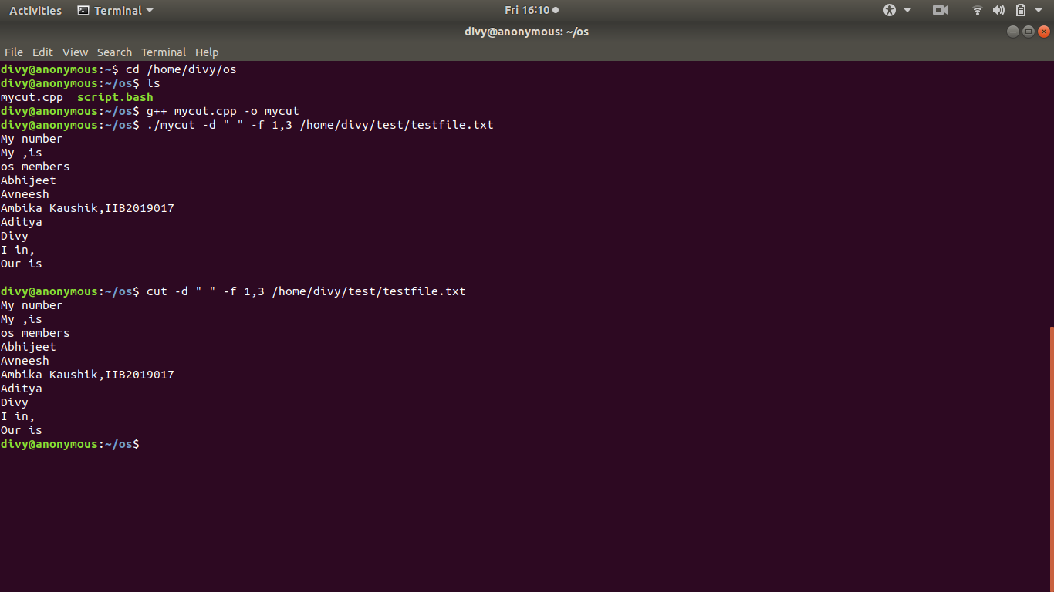

Slide 25
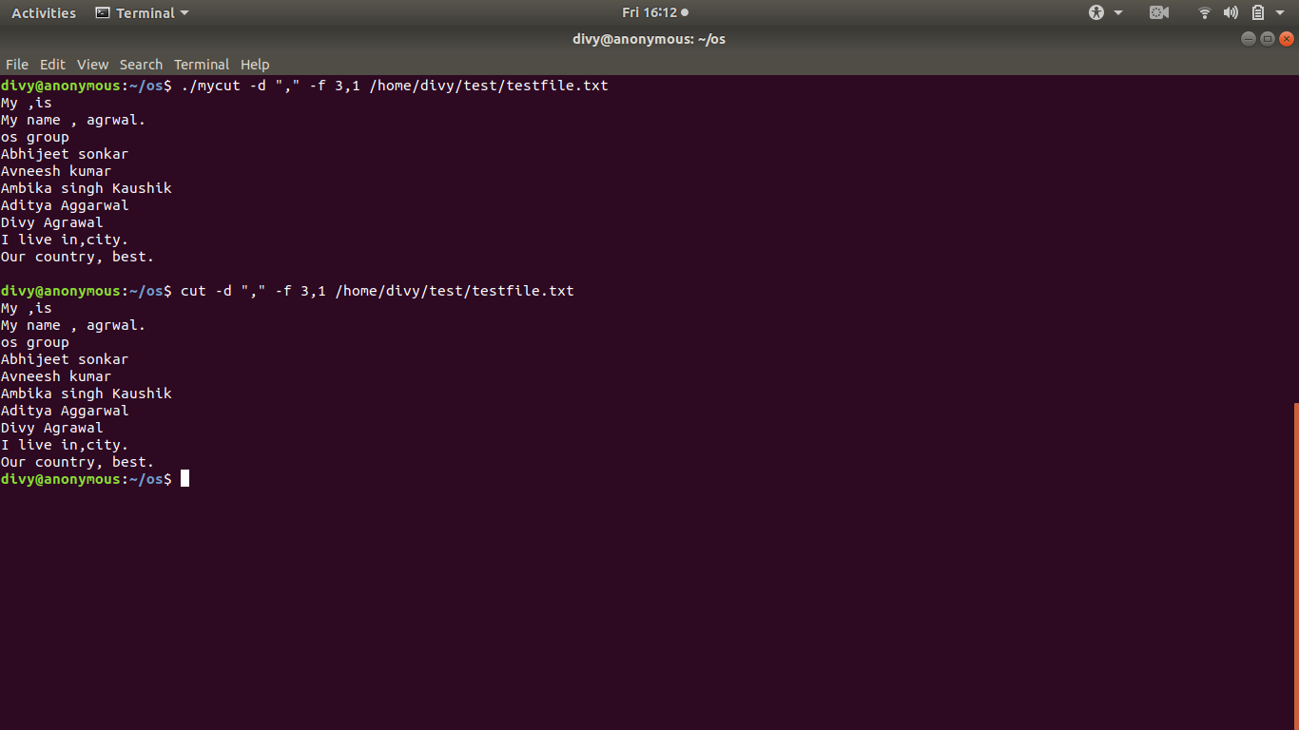

Slide 26
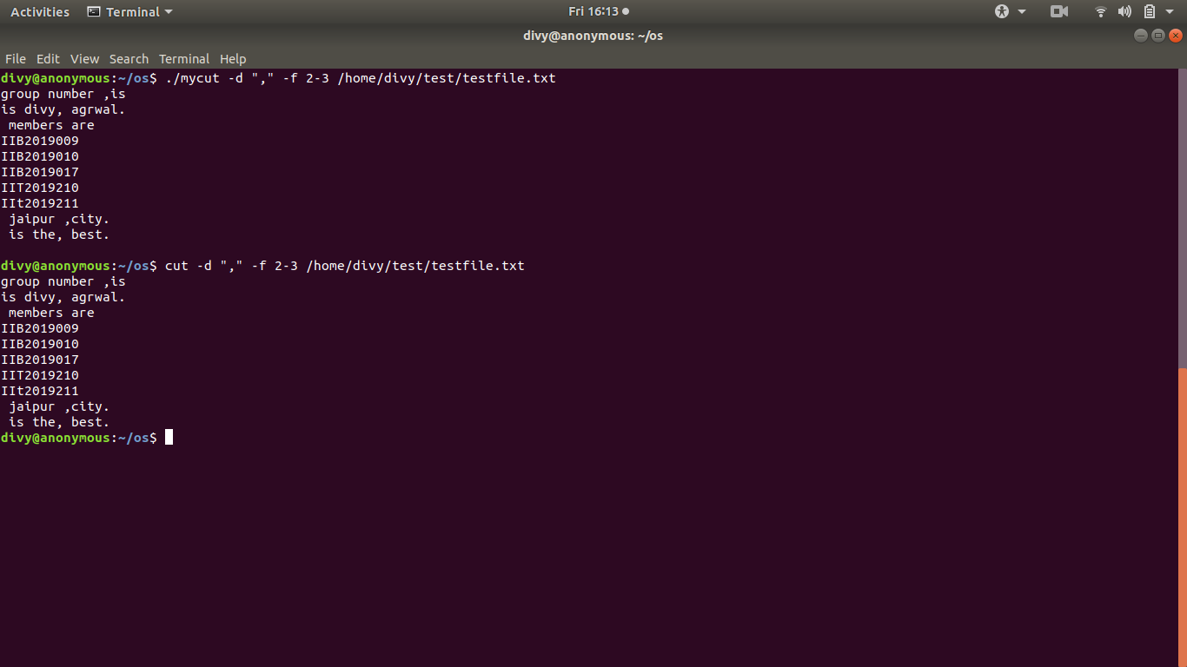

Slide 27
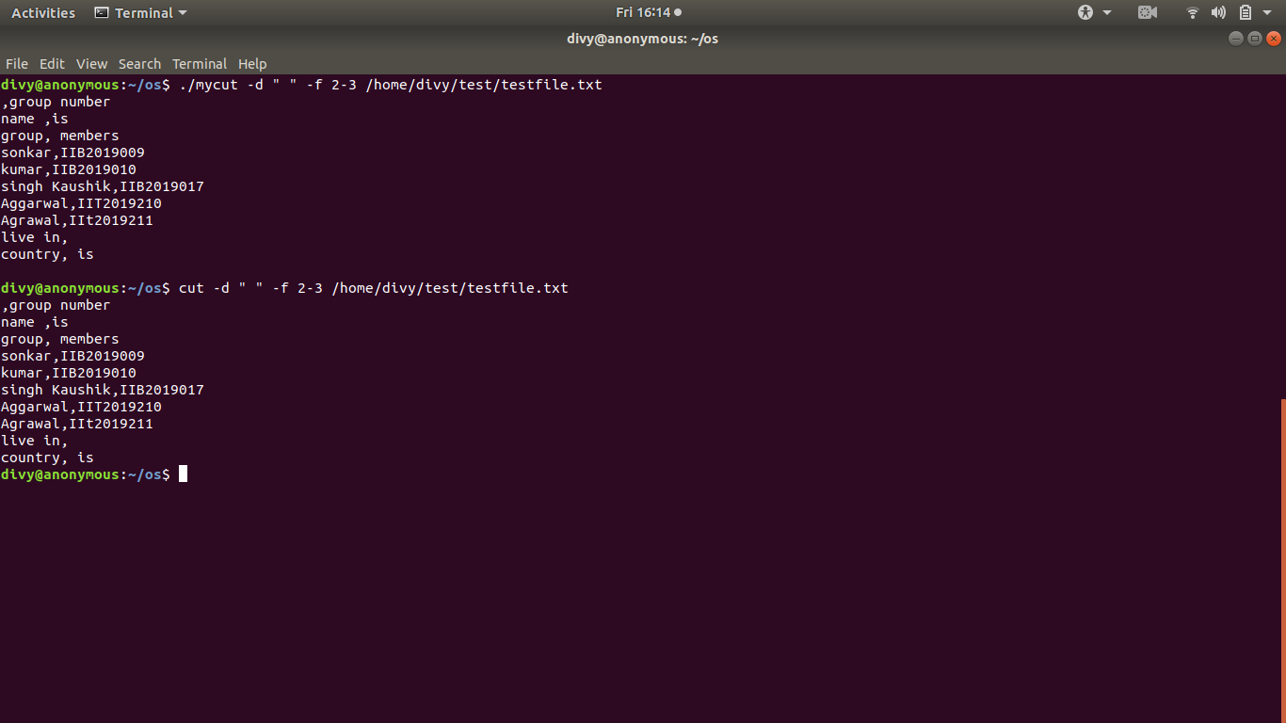

Slide 28
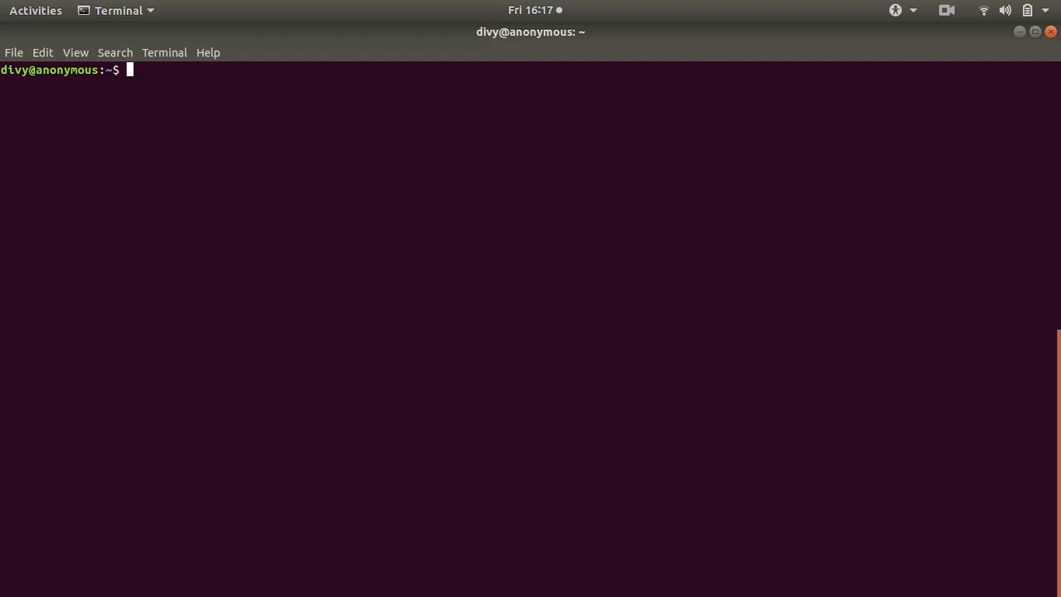

Slide 29
Output of script.bash

Slide 30
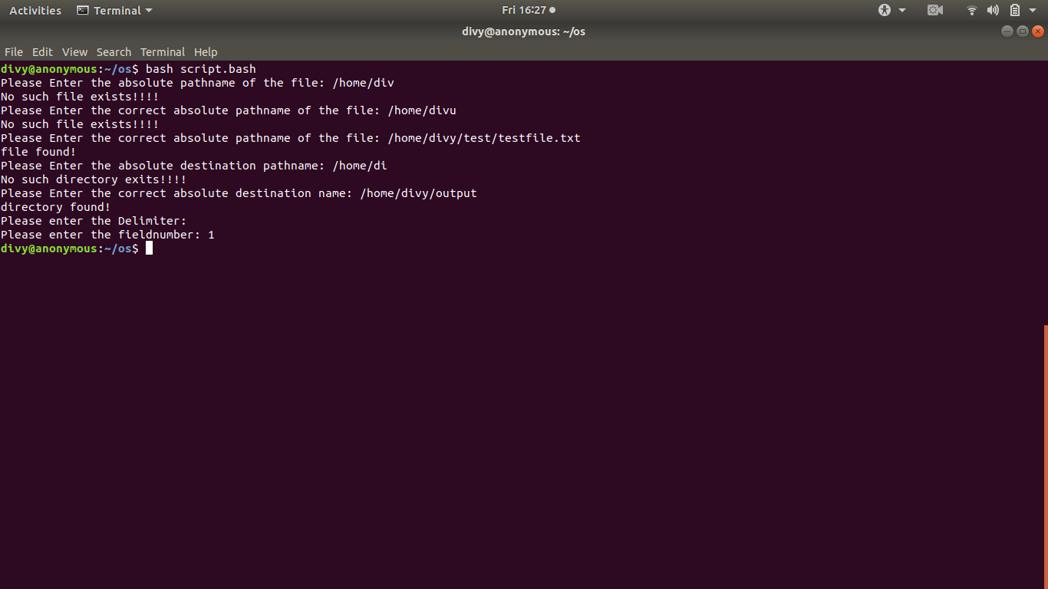

Slide 31
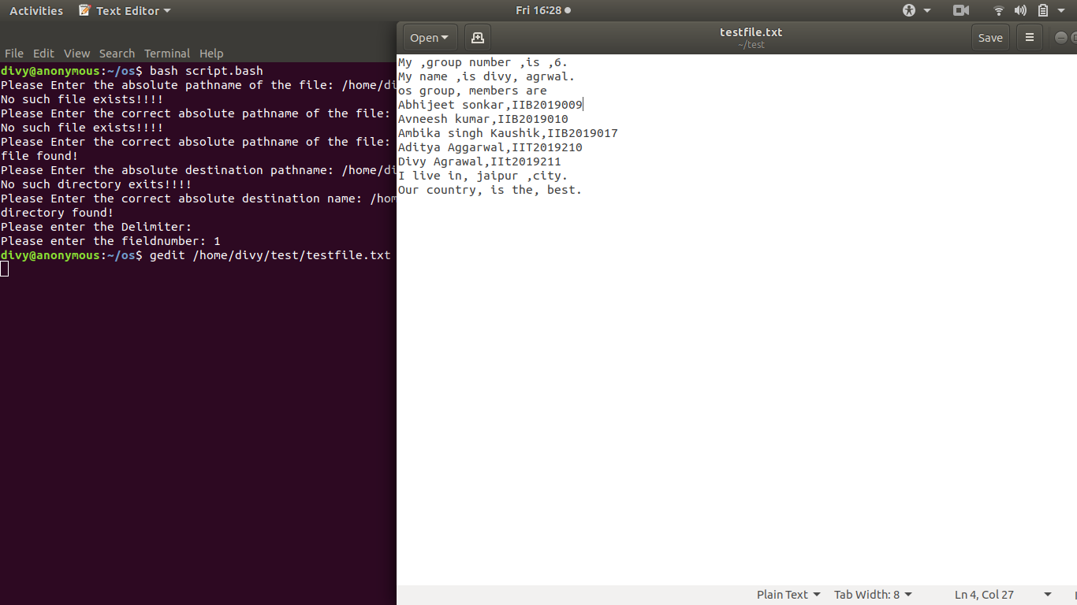

Slide 32
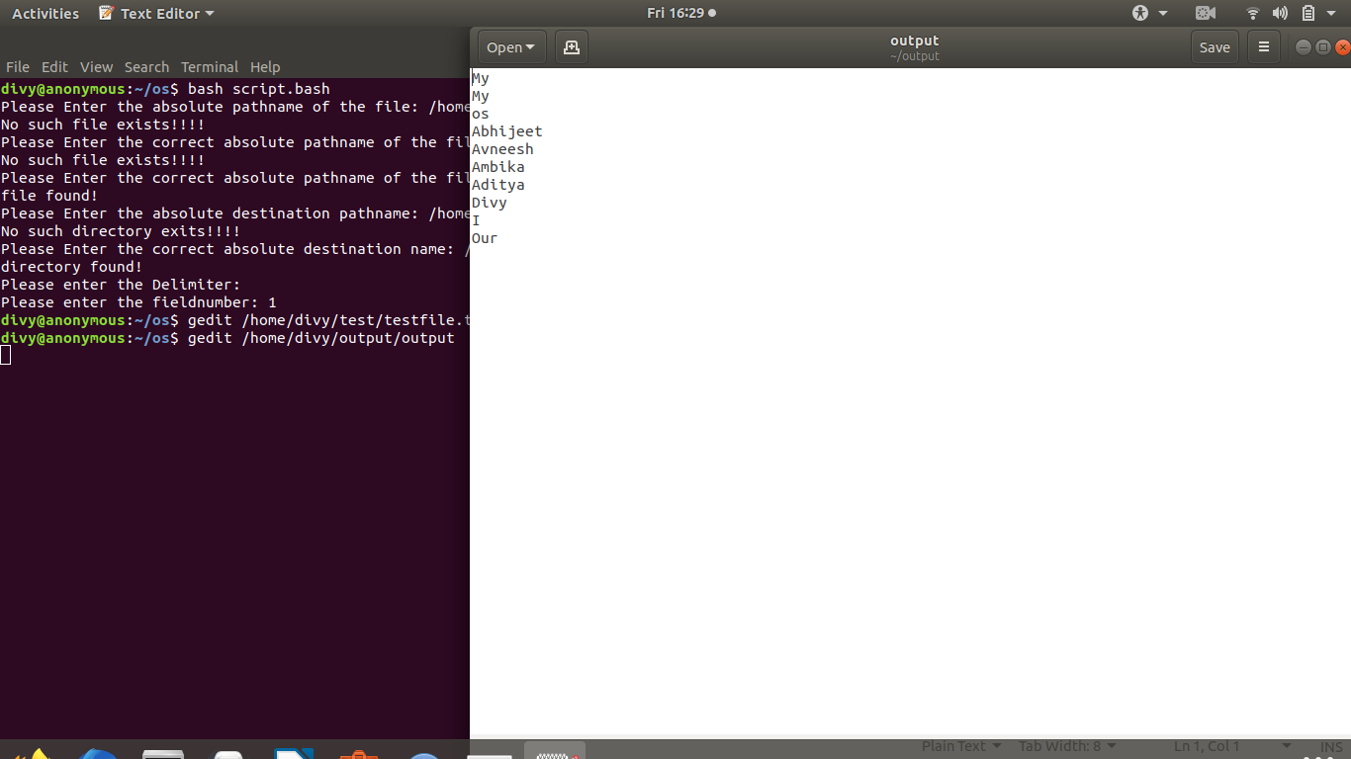

Slide 33
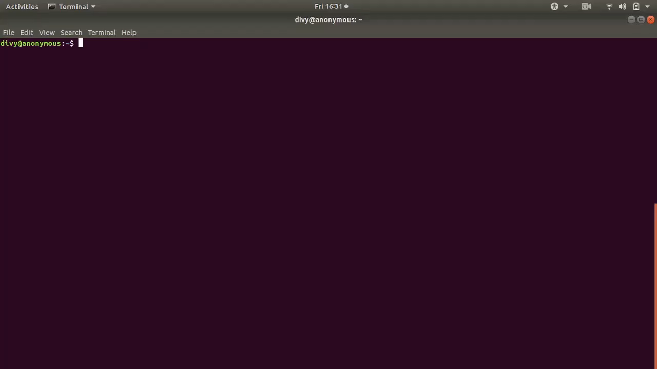

Slide 34
THANK YOU

